Slide 1
Final Year Project (FYP) Report Writing Guide
by Wong Wei Ru

Slide 2
Final Year Project (FYP)
Semester 1
Progress report
Semester 2
Final report (thesis)
Presentation
Presentation

Slide 3
Progress report contents
Introduction – background of your research topic and give the problem statement.
Motivation – why is it important to solve this problem? Any existing solutions? The pros and cons of these solutions. Why need further work?
Objective(s) – what do you want to achieve in your project?
Research Methodology – how and what to do to achieve your objective(s)?
Your work done so far in the first semester (in detail) – report only your original work and results, not results from other papers. (Results and discussion)
Planning for the second semester (Gantt Chart)
References: include only relevant references, from reliable sources

Slide 4
Final report contents
Introduction
Literature review
Methodology
Results
Discussion
Conclusion and future work

Slide 5
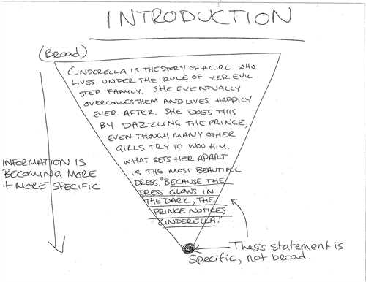
Introduction and Motivation
Tell a story – create a storyboard
Start with an overview then narrow down to the problem you wish to solve
There is no limit on how long this chapter should be – should be scientifically thick
Show lots of references
Important:
NO spelling errors, typo
NO “cut and paste”
NO abbreviation without definition

Slide 6
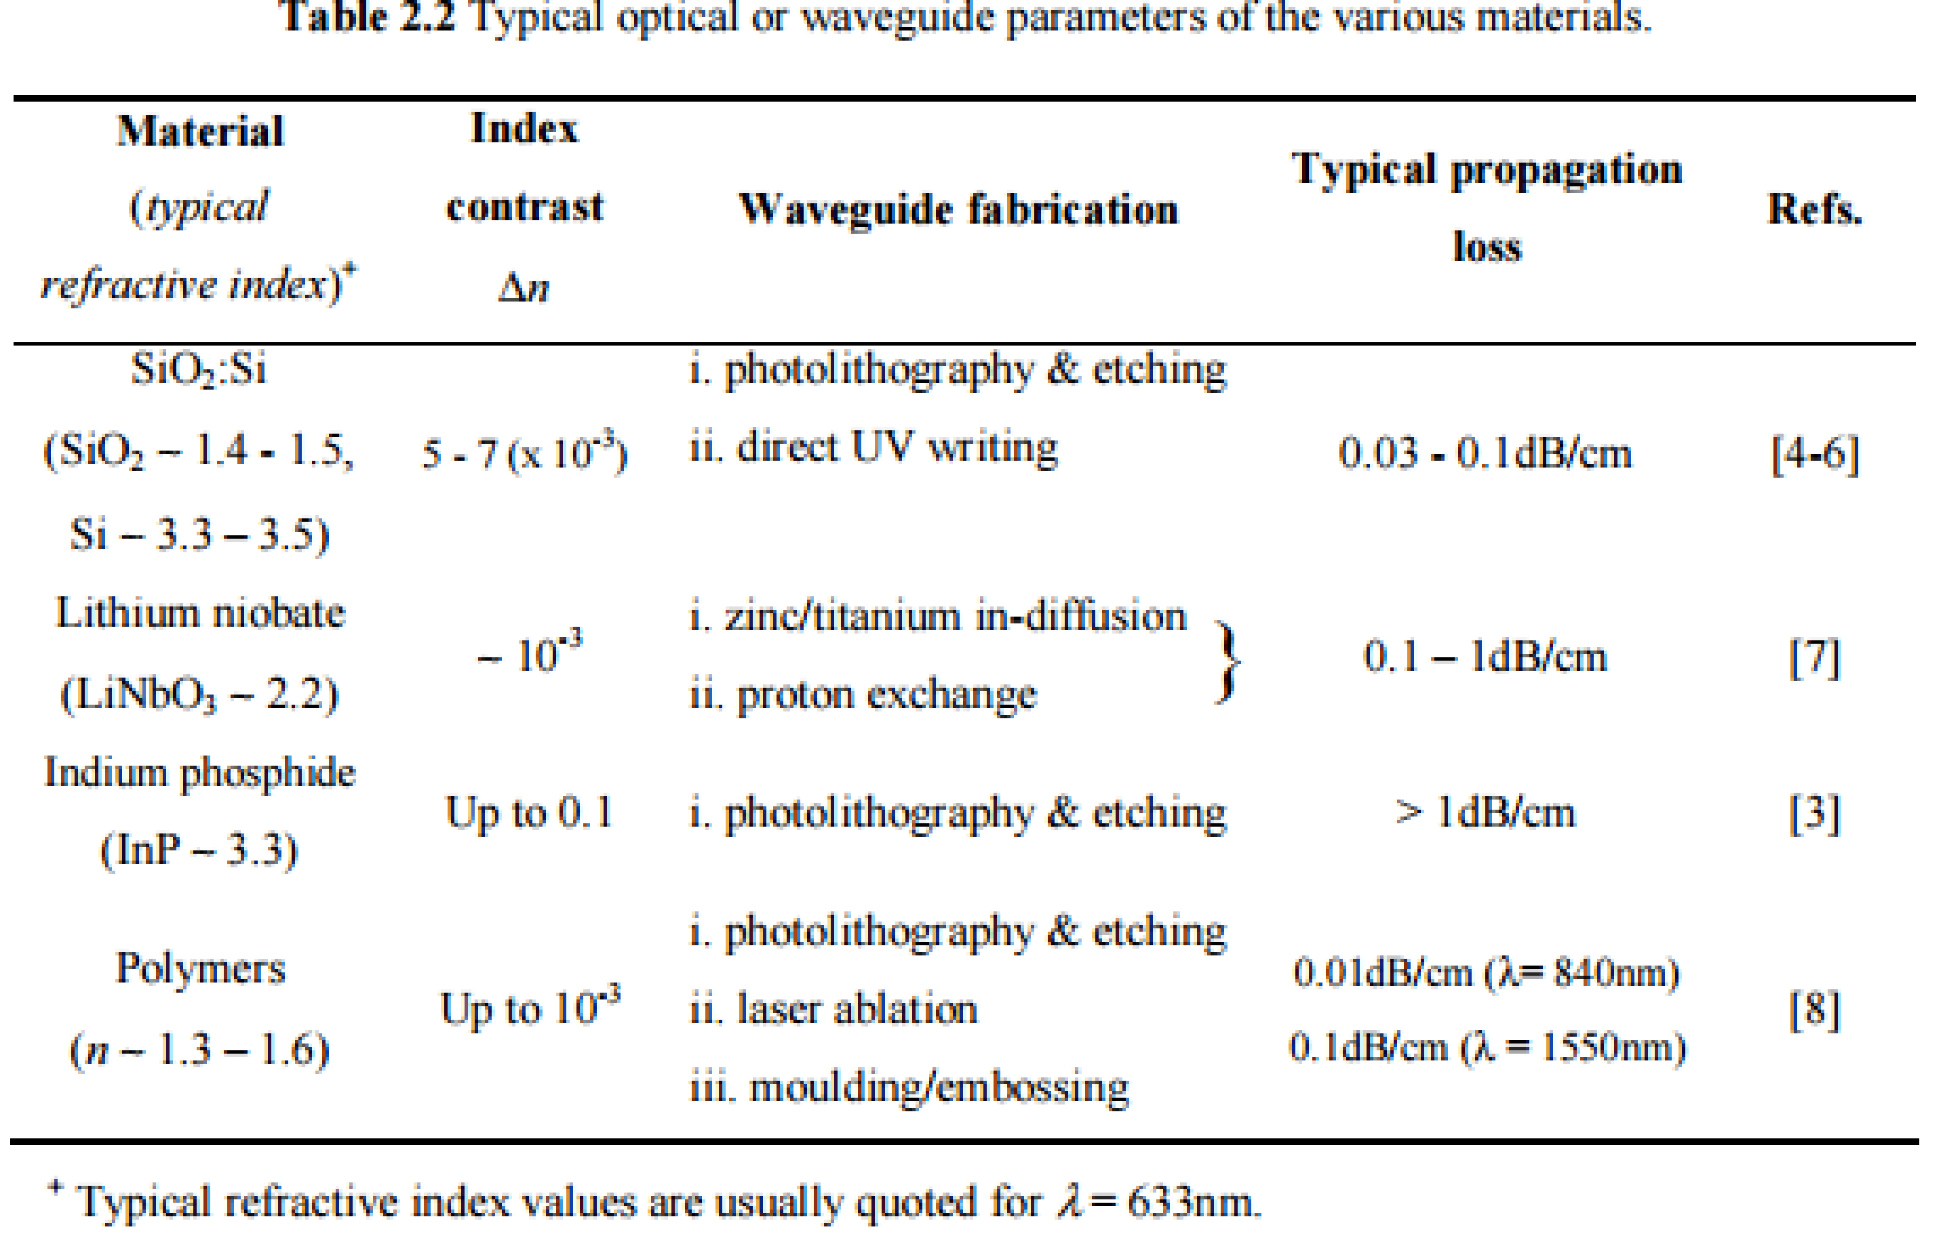
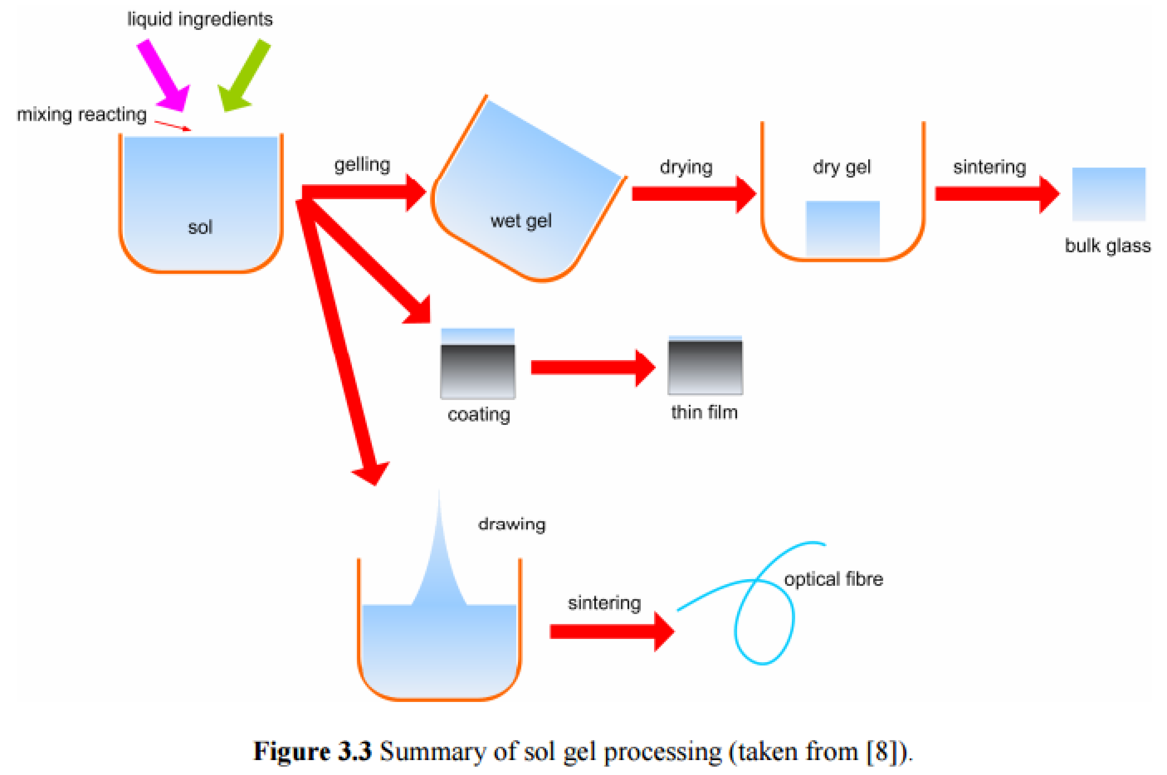
Introduction and Motivation
Use tables, flow diagrams, images, composite graphs, etc.

Slide 7
Literature review
A literature review provides extensive background information on past studies and current knowledge pertaining to the research topic.
A critical literature review is a critical assessment of the relevant literature. It is directly related to the research, providing information on theories, models, materials and techniques used in the research.
The literature review should be comprehensive and include recent publications which are relevant to the research.

Slide 8
Methodology
This chapter describes and explains the materials as well as the research methodology used in the study.
The sub-topics for this chapter include the key research questions, the research design, and the research procedures adopted.
It may also, where appropriate, indicate sampling methods, research instruments and statistical methods employed.
The purpose of this is to inform the reader on the methods used to collect the data and generate the findings reported.
A technical report is not the same as a lab report!

Slide 9
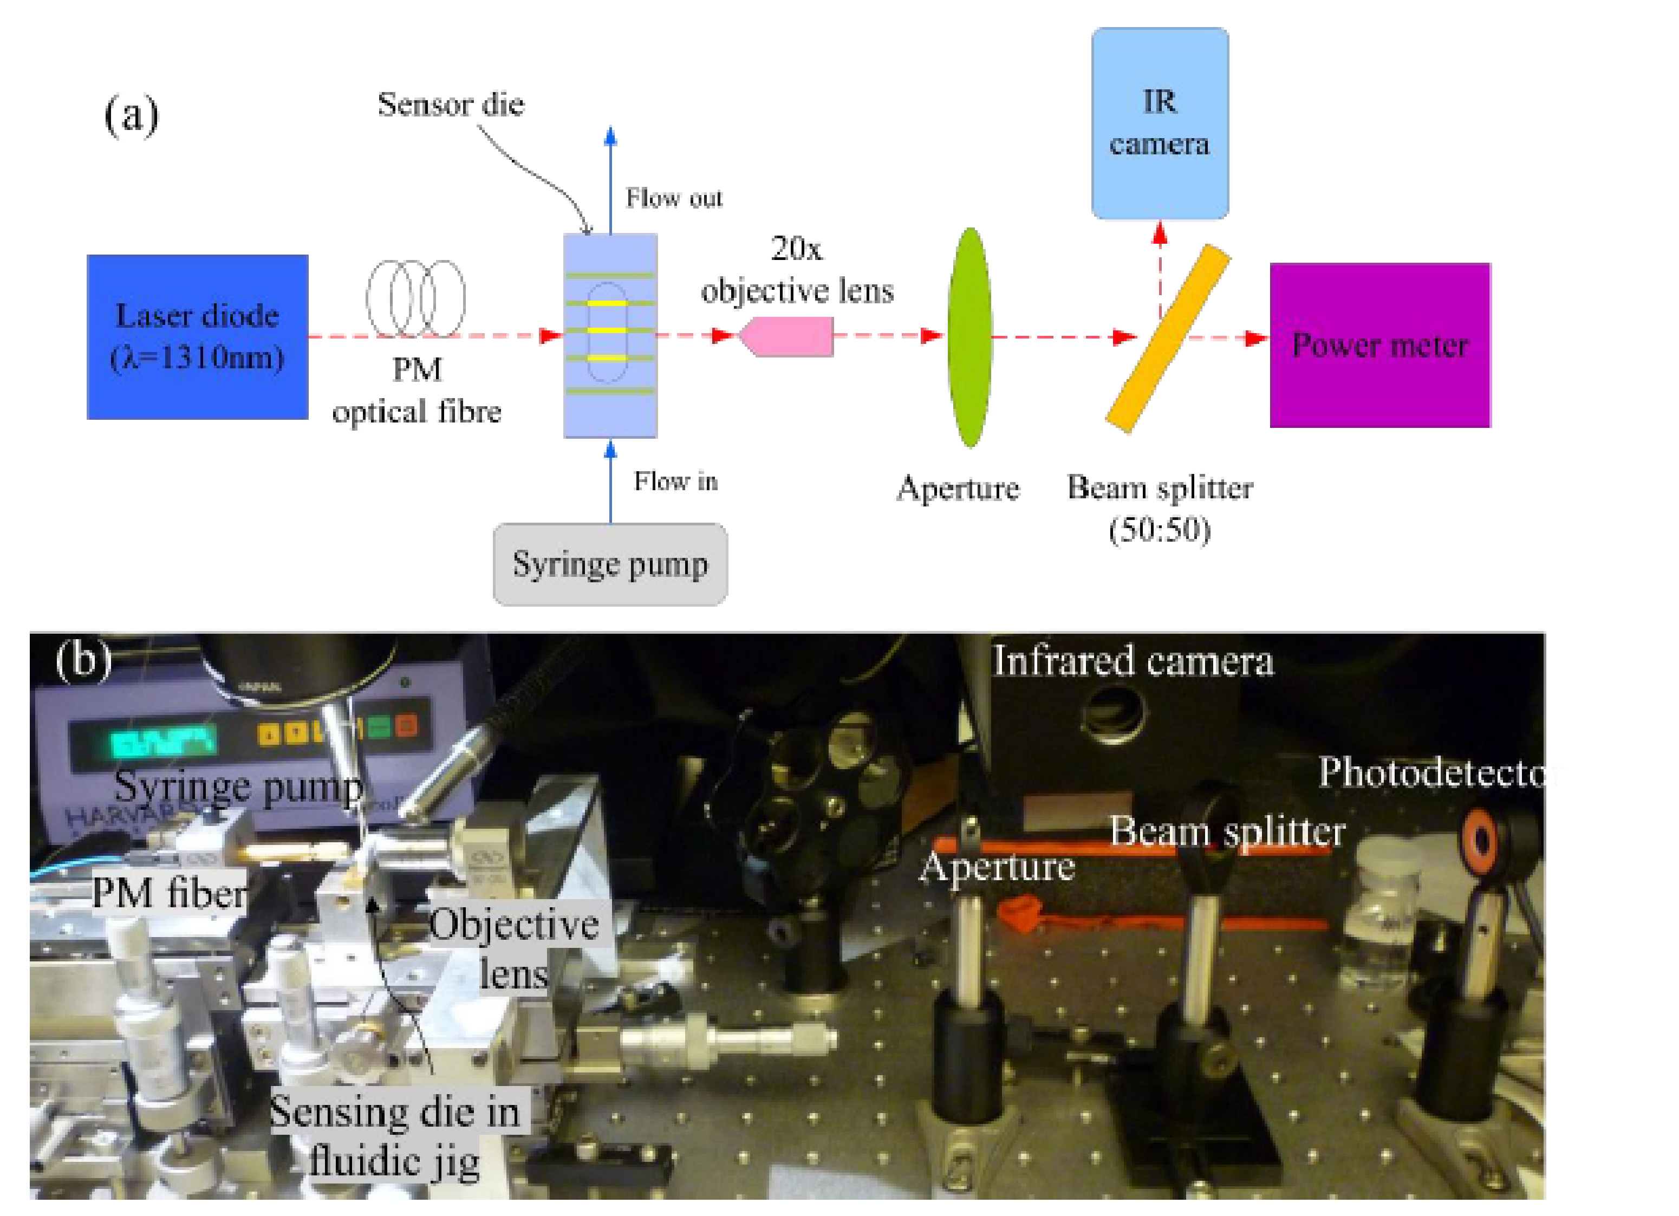
Methodology
Take a lot of photos during your work

Slide 10
Results and discussion
Results and discussion can be two separated chapters or combined in a single chapter.
Results
This chapter explains the results which are commonly presented in the form of text, figures and tables, complete with data analysis.
Discussion
This chapter contains the interpretation of the results. The findings of the research should be compared and contrasted with those of previous studies presented in the literature review.
The purpose of this chapter is to discuss the findings and the outcomes of the research in relation to the results that have been obtained.
Relate your findings with the fundamental theory

Slide 11
Gantt chart
 | W1 | W2 | W3 | W4 | W5 | W6
Task 1
Task 2
Task 3
Task 4
Sep 2016
Oct 2016
Nov 2016
Dec 2016
Task 1
Task 2
Task 3
Task 4
Project Tasks | 2016 |  |  |  | 2017
 | S | O | N | D | J | F | M
Task 1
Task 2
Task 3
Task 4
Activity/Week | 1 | 2 | 3 | 4 | 5 | 6 | 7
Task 1
Task 2
Task 3
Task 4
Completed work
Work to be completed

Slide 12
Conclusion and future work
In this chapter, the findings are summarized and their implications discussed.
This section may include suggestions for future work.
Usually the conclusions are made based on the objectives set in Chapter 1.

Slide 13
Progress report format
must be typed and printed on single-sided A4 paper
font type Times New Roman, font size 12 and justified
The body of the text should be typed with 1.5 spacing.
For mathematical texts, the use of Equation Editor or LaTeX – do not use print-screen
Margin:
Top : 2.0 cm or 0.79 inch
Right : 2.0 cm or 0.79 inch
Left : 4.0 cm or 1.57 inch
Bottom : 2.0 cm or 0.79 inch

Slide 14
Preface
Title Page
Abstract
Acknowledgements / Dedication
Table of Contents
List of Figures
List of Tables
List of Symbols and Abbreviations
List of Appendices (optional)

Slide 15
Title page
This page is the first page of Roman numeral page number but it is not numbered.
The text should be typed using font type Times New Roman, font size 14 with 1.15 pt. line spacing

Slide 16
Numbering of chapters
Chapters and sub-chapters must be numbered using Arabic numerals (1, 2, 3, …).
Example:
CHAPTER 2: FIRST LEVEL (CHAPTER TITLE)
2.1 Level 2 (sub-title)
2.1.1 Level 3 (sub-sub-title)
2.1.1.1 Level 4 (sub-sub-sub-title)
Please avoid to create sub-chapters beyond the fourth nesting level.

Slide 17
Page numbering
The page numbers should be placed at the right hand side without any punctuation.
Font type Times New Roman and font size 10 recommended for numbers.
Roman numerals (i, ii, iii etc) should be used in the Preface section. The first page of the thesis, the title page, is an unnumbered page ‘i’. Numbering begins on the second page with ‘ii’.
Arabic numerals (1, 2, 3) are used on the pages of the text (starting with the Introduction page) and Supplementary section.

Slide 18
Figures
Figures contain graphs, illustrations or photographs
Figures are placed within the body of the text at the centre of the frame.
The labels (captions) are placed at the bottom of the figure.
Figures are labelled according to the chapter in which they appear. For example, figures in Chapter 3 are numbered sequentially: Figure 3.1, Figure 3.2.
If the figure contains a citation, the source of the reference should be placed after the label.

Slide 19
Figures (example)
Figure 3.1: Title (Gibson, 2015)

Slide 20
Tables
Tables are printed within the body of the text at the centre of the frame and labelled according to the chapter in which they appear.
The caption should be placed above the table itself.
If the table contains a citation, the source of the reference should be included in the table caption.

Slide 21
Tables (example)
Table 3.1: Title (Gibson, 2015)
Heading 1 | Heading 2
Text | Text
Text | Text

Slide 22
References
All works or studies referred to in the research report in the form of quotations or citations must be included in the references.
The references should be written consistently in the American Psychological Association (APA) format or in another format set by the department.
APA format:
Each reference should be written in single spacing format and a double space should be left between references.
The list of references must be arranged in alphabetical order and the entries should not be numbered.
The list must also have a hanging indentation of 0.5 inch.

Slide 23
APA format
Books: Author, A. A. (Year of publication). Title. Location: Publisher.
Buchwalow, I. B., & Böcker, W. (2010). Immunohistochemistry: Basics and methods. Berlin: Springer Verlag.
Journal article: Author, A. A., Author, B. B., & Author, C. C. (Year). Title of article. Title of Periodical, volume number(issue number), pages.
Scruton, R. (1996). The eclipse of listening. The New Criterion, 15(30), 5-13.
Please refer to APA-Guide for more style format.

Slide 24
APA format - citations
For summaries or paraphrases, the last name of the author and the year of publication must be included for the in-text reference.
Example:
Kingston and Parker (2012) found the biggest challenges in classroom to be ….
The biggest challenges in classroom were …. (Kingston & Parker, 2012).

Slide 25
IEEE format
Books:
[1] L. Stein, “Random patterns,” in Computers and You, J. S. Brake, Ed. New York: Wiley, 1994, pp. 55-70.
Journal article:
R. E. Kalman, “New results in linear filtering and prediction theory,” J. Basic Eng., ser. D, vol. 83, pp. 95-108, Mar. 1961.
Thesis
[1] J. O. Williams, “Narrow-band analyzer,” Ph.D. dissertation, Dept. Elect. Eng., Harvard Univ., Cambridge, MA, 1993.
[2] N. Kawasaki, “Parametric study of thermal and chemical nonequilibrium nozzle flow,” M.S. thesis, Dept. Electron. Eng., Osaka Univ., Osaka, Japan, 1993.

Slide 26
IEEE format - citations
References in Text:
as shown by Brown [4], [5]
as mentioned earlier [2], [4]–[7], [9]
Smith [4] and Brown and Jones [5]
Wood et al. [7]
NOTE: Use et al. when three or more names are given.

Slide 27
EndNote
EndNote is a bibliography and manuscript maker—it formats citations, figures, and tables in Microsoft® Word with the Cite While You Write™ feature.
Install EndNote to help your reference citations and formatting: http://software.um.edu.my/endnote.html
Guide to use EndNote: How To Use EndNote in 7 Minutes (Windows Version)
https://www.youtube.com/watch?v=lnqPjjKwEPk

Slide 28

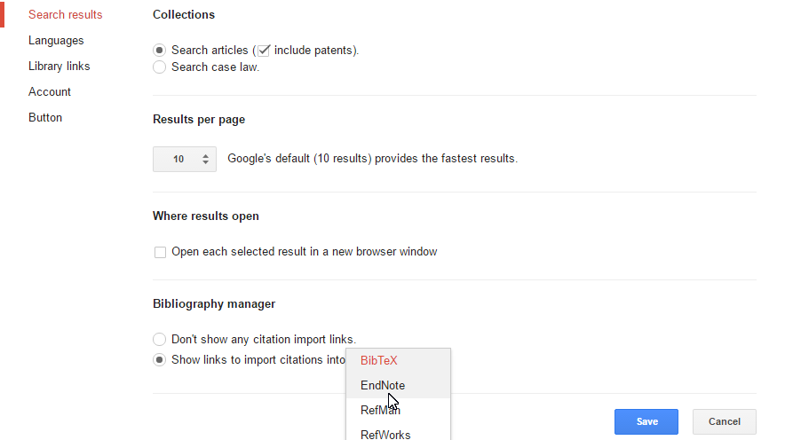
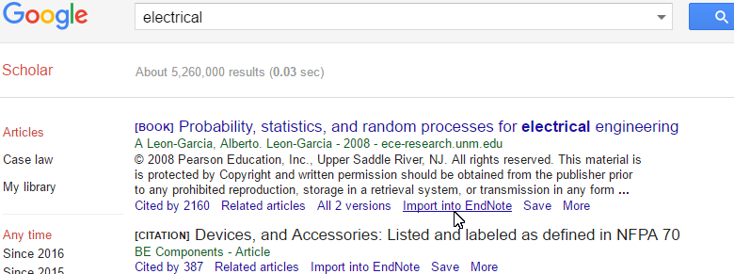
EndNote
Create a new library.
Add your references: manually, online database or Google Scholar.
Google Scholar: Settings

Slide 29
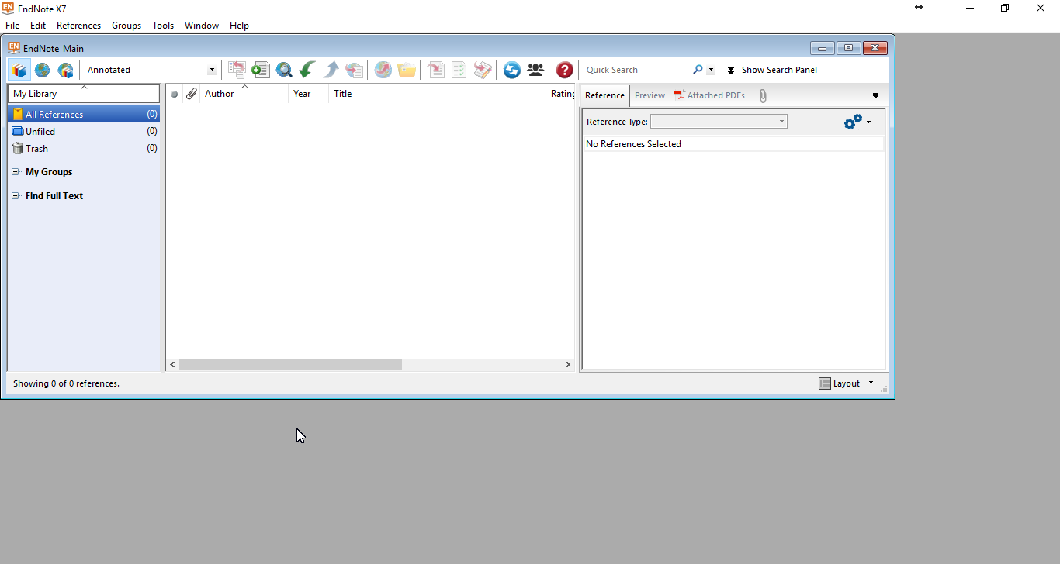

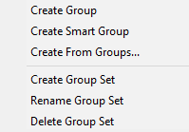
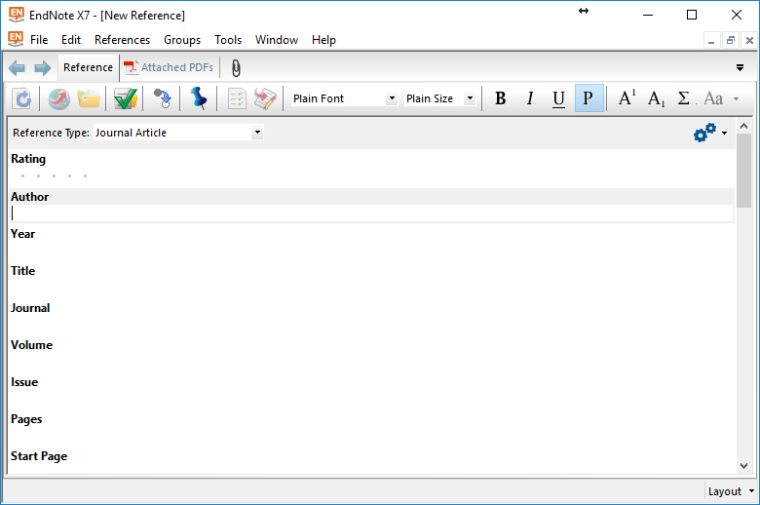
EndNote interface
Search for online references
Add new reference manually
Select different referencing style
Group your references
Add new reference manually

Slide 30
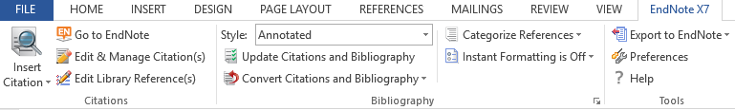
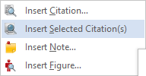
Cite while you write
In your Microsoft Word, there is an add-on for EndNote.

Slide 31
Plagiarism
Plagiarism is defined as the use of original work, ideas or actual texts created by others, without acknowledging the original source. Hence, failure to acknowledge the work of others in their work means the candidate is guilty of plagiarism and may be subjected to disciplinary action under the University of Malaya (Discipline of Students) Rules 1999.
Please use Turnitin, an online web-based plagiarism detection application to avoid plagiarism and ensure academic integrity. In most cases, the similarity index percentage should not be more than 10% to 25%.

Slide 32


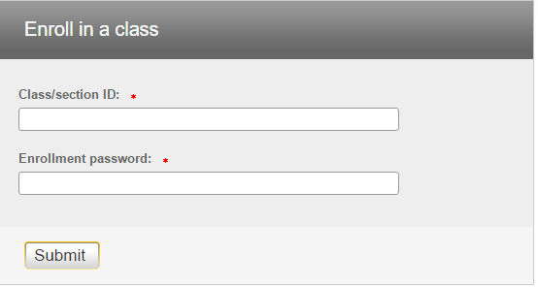
Turnitin
Create an account at http://turnitin.com/ using your siswa mail.
Enroll in a class using the following details:
Class ID changes every semester. Please get it from reference desk at main library
Class ID =
Password =1234

